Slide 1
Basic Electrical Technology [ELE 1051]
Chapter 3 - Single Phase AC Circuits
(3.2)

Slide 2

Complex Number
A complex number is of the form a + i b
Represented on complex plane as:
Imaginary
b
$$(a+ib)$$
0
a
Real
Notes:
Picture Courtesy: Google

Slide 3

The operator ‘j’
$$j=1∠90°$$
The operator ‘j’ rotates the given vector by 90 degrees in anti-clockwise direction

Slide 4



Rectangular ↔ Polar conversion
Rectangular to polar:
$\left|a\right|=\sqrt{x^{2}+y^{2}}$
$θ=\tan^{−1}{\frac{y}{x}}$
Polar to Rectangular:
$x=\left|a\right|\cos{θ}$
$y=\left|a\right|\sin{θ}$
Imaginary
y
$$(x+iy)$$
|a|
$$θ$$
x
Real
0

Slide 5

Representation of a complex number
Rectangular form: $a=x±jy$
Polar form: $a=\left|a\right|\text{∠}±θ$
Exponential form: ${a=\left|a\right|e}^{±jθ}$
Trigonometric form: $a=|a|(cosθ±jsinθ)$

Slide 6

Rectangular ↔ Polar conversion
Convert the following into polar form
3 + j 4 = 5 ∠53.13$°$
8 + j 6 = 10 ∠36.87$°$
8 – j 6 = 10 ∠-36.87$°$
Convert the following into rectangular form
5 ∠30$°$ = 4.33 + j 2.5
3 ∠-60$°$ = 1.5 – j 2.59
-(10 ∠45$°$) = - 7.07 – j 7.07

Slide 7
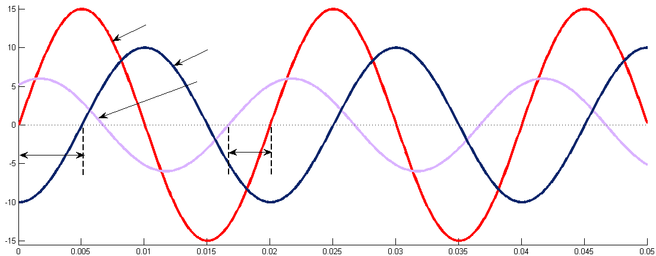












Representing AC
Consider three sinusoidal signals $x\left(t\right), y\left(t\right) \& z(t)$ with same frequency
Mathematical Representation
Graphical Representation
$$x(t)=X_{m}sin⁡(ωt)$$
$$y(t)=Y_{m}\sin\left(ωt−∅\right)$$
$$z(t)=Z_{m}\sin\left(ωt+θ\right)$$
$$x(t)$$
$$y(t)$$
$$z(t)$$
Amplitude →
$$∅$$
$$θ$$
Phasor Representation
$$Z_{rms}$$
Time →
$$θ$$
Representing the relationship between sinusoidal signals with same frequency in graphical or mathematical form is tedious
Phasor representation is often used
$$∅$$
$$X_{rms}$$
$$Y_{rms}$$

Slide 8
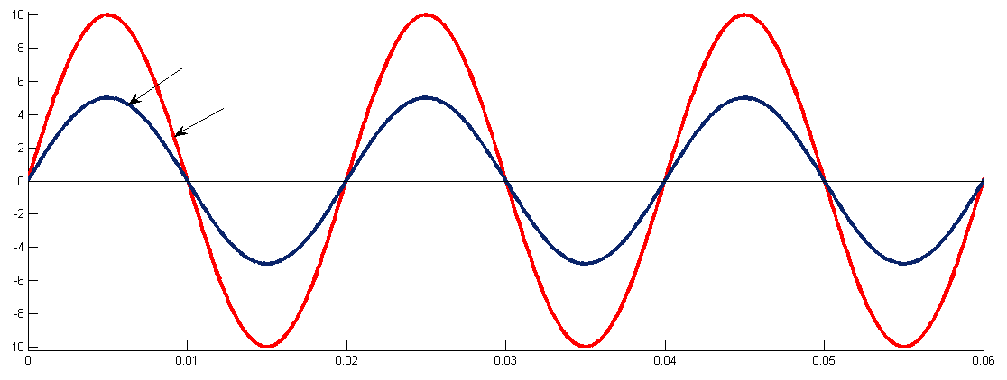



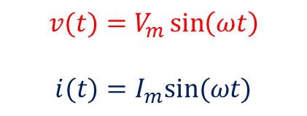





R circuit response with AC supply
$$i(t)$$
‘Current through the resistor
is in phase with the voltage across it’
$$v(t)$$
$$i\left(t\right)=\frac{v(t)}{R}$$
$$R$$
f = 50 Hz
Graphical Representation
Mathematical Representation
$$i(t)$$
$$v(t)=V_{m}\sin\left(ωt\right)$$
$$i(t)=I_{m}sin⁡(ωt)$$
$$v(t)$$
Amplitude →
Phasor Representation
$$I_{rms}$$
$$V_{rms}$$
Time →

Slide 9
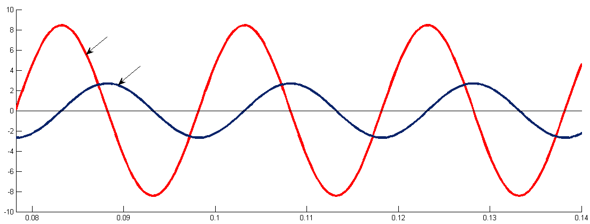








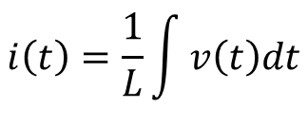


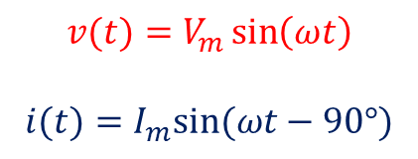


L circuit response with AC supply
$$i(t)$$
‘Current through the inductor lags the voltage across it by 90$°$’
$$i\left(t\right)=\frac{1}{L}\int{v\left(t\right)dt}$$
$$v(t)$$
$$L$$
$$\overline{V}=V∠0°$$
$$\overline{I}=I∠−90°$$
$$\frac{\overline{V}}{\overline{I}}=\frac{V∠0°}{I∠−90° }=jX_{L}$$
$$where \frac{V}{I}=X_{L}$$
f = 50 Hz
$$X_{L} is called Inductive Reactance$$
Graphical Representation
Mathematical Representation
$$v(t)$$
$$v(t)=V_{m}\sin\left(ωt\right)$$
$$i(t)=I_{m}sin⁡(ωt−90°)$$
$$i(t)$$
Amplitude →
Phasor Representation
$$V_{rms}$$
Time →
$$I_{rms}$$
Notes:
Derive in class v(t) and i(t) for L to find X_{L}.

Slide 10
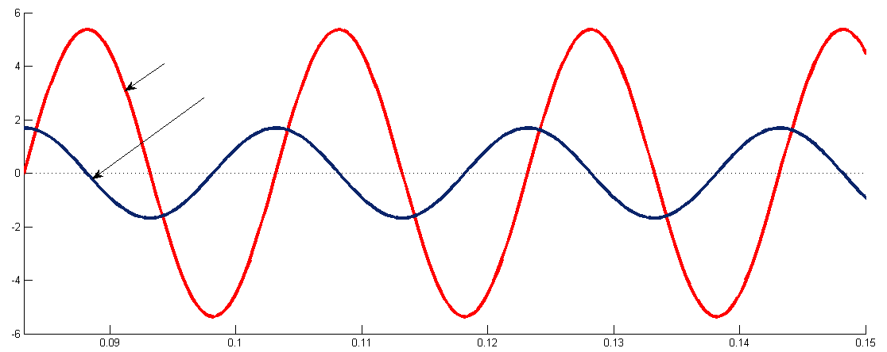













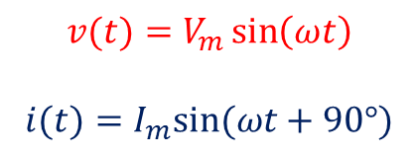

C circuit response with AC supply
$$i(t)$$
‘Current through the capacitor
leads the voltage across it by 90$°$’
$$i\left(t\right)=C\frac{dv(t)}{dt}$$
$$v(t)$$
$$C$$
$$\overline{V}=V∠0°$$
$$\overline{I}=I∠90°$$
f = 50 Hz
$$\frac{\overline{V}}{\overline{I}}=\frac{V∠0°}{I∠90° }=−jX_{C}$$
$$where \frac{V}{I}=X_{C}$$
$$X_{C} is called Capacitive Reactance$$
Graphical Representation
Mathematical Representation
$$v(t)$$
$$v(t)=V_{m}\sin\left(ωt\right)$$
$$i(t)=I_{m}sin⁡(ωt+90°)$$
$$i(t)$$
Amplitude →
Phasor Representation
$$I_{rms}$$
$$V_{rms}$$
Time →
Notes:
Derive in class v(t) and i(t) for C to find X_{C}.

Slide 11
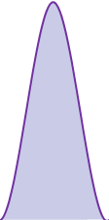

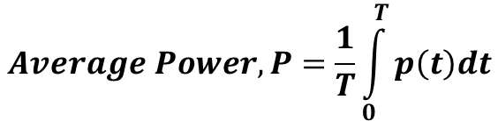

Power Associated - Pure Resistive Circuit
$$p\left(t\right)$$
Instantaneous power,
$$p\left(t\right)=v\left(t\right).i(t)=V_{m}I_{m}\sin^{2}ωt$$
$$v\left(t\right)$$
$$Average Power, P=\frac{1}{T}\int_{0}^{T}{p\left(t\right)dt}$$
Amplitude
$$i\left(t\right)$$
0.02
0.04
0.06
Time(sec)
$$P_{avg}=\frac{V_{m}I_{m}}{2}=V_{rms}I_{rms}=\frac{V_{rms}^{2}}{R}=I_{rms}^{2}R$$

Slide 12


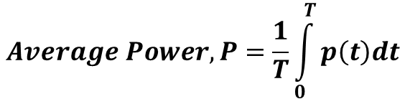

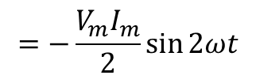
Power Associated – Pure Inductive Circuit
$$P\left(t\right)$$
Instantaneous power,
$$v\left(t\right)$$
$$p\left(t\right)=v\left(t\right).i(t)$$
$$=V_{m}I_{m}\sin{ωt}.\sin{(ωt−90}°)$$
Amplitude
$$i\left(t\right)$$
$$=−\frac{V_{m}I_{m}}{2}\sin{2ωt}$$
0.02
0.04
0.06
Time(sec)
$$Average Power, P=\frac{1}{T}\int_{0}^{T}{p\left(t\right)dt}$$
$$P_{avg}=0$$

Slide 13


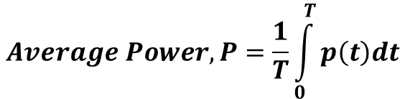

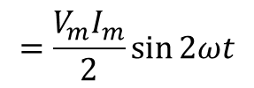
Power Associated – Pure capacitive Circuit
$$P\left(t\right)$$
Instantaneous power,
Amplitude
$$p\left(t\right)=v\left(t\right).i(t)$$
$$v\left(t\right)$$
$$=V_{m}I_{m}\sin{ωt}.\sin{(ωt+90}°)$$
$$=\frac{V_{m}I_{m}}{2}\sin{2ωt}$$
$$i\left(t\right)$$
0.02
0.04
0.06
Time(sec)
$$Average Power, P=\frac{1}{T}\int_{0}^{T}{p\left(t\right)dt}$$
$$P_{avg}=0$$

Slide 14

Thank You!

